Slide 1
COLLECTION FRAMEWORK

Slide 2
The Collection framework represents a unified architecture for storing and manipulating a group of objects. It has:
Interfaces and its implementations, i.e., classes
Algorithm
The java.util package contains all the classes and interfaces for the Collection framework.

Slide 3
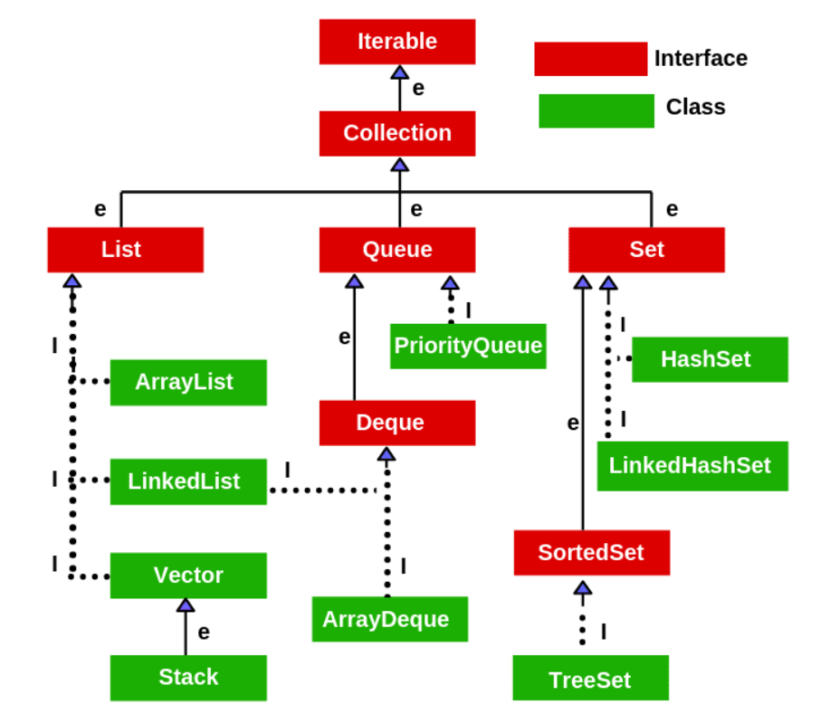
Collection framework hierarchy

Slide 4
Iterable interface
Iterable Interface
The Iterable interface is the root interface for all the collection classes. The Collection interface extends the Iterable interface and therefore all the subclasses of Collection interface also implement the Iterable interface.
It contains only one abstract method → Iterator<T> iterator()

Slide 5
Collection interface
The Collection interface is the interface which is implemented by all the classes in the collection framework.
It declares the methods that every collection will have.
Some of the methods of Collection interface are Boolean add ( Object obj), Boolean addAll ( Collection c), void clear(), etc. which are implemented by all the subclasses of Collection interface.

Slide 6
ARRAYLIST
Java ArrayList class uses a dynamic array for storing the elements.
It is like an array, but there is no size limit. We can add or remove elements anytime.
Comes from java.util package.
The ArrayList in Java can have the duplicate elements also.
It implements the List interface so we can use all the methods of the List interface here.
The ArrayList maintains the insertion order internally.
Java ArrayList allows random access because the array works on an index basis.
In ArrayList, manipulation is a little bit slower than the LinkedList in Java because a lot of shifting needs to occur if any element is removed from the array list.
We can not create an array list of the primitive types, such as int, float, char, etc. It is required to use the required wrapper class in such cases. For example:
ArrayList<int> al = ArrayList<int>();
ArrayList<Integer> al = new ArrayList<Integer>();

Slide 7
LINKED LIST
Java LinkedList class uses a doubly linked list to store the elements.
It provides a linked-list data structure.
It inherits the AbstractList class and implements List and Deque interfaces.
Java LinkedList class can contain duplicate elements.
Java LinkedList class maintains insertion order.
Java LinkedList class is non synchronized.
In Java LinkedList class, manipulation is fast because no shifting needs to occur.
Java LinkedList class can be used as a list, stack or queue.

Slide 8
LIST INTERFACE
List in Java provides the facility to maintain the ordered collection. It contains the index-based methods to insert, update, delete and search the elements.
It can have the duplicate elements also. We can also store the null elements in the list.
The List interface is found in the java.util package and inherits the Collection interface.
List is an interface whereas ArrayList is the implementation class of List.

Slide 9
HASHSET
Java HashSet class is used to create a collection that uses a hash table for storage. It inherits the AbstractSet class and implements Set interface.
HashSet stores the elements by using a mechanism called hashing.
HashSet contains unique elements only.
HashSet allows null value.
HashSet class is non synchronized.
HashSet doesn't maintain the insertion order. Here, elements are inserted on the basis of their hashcode.
HashSet is the best approach for search operations.
A list can contain duplicate elements whereas Set contains unique elements only.

Slide 10
Linked hashset
Java LinkedHashSet class is a Hashtable and Linked list implementation of the Set interface.
It inherits the HashSet class and implements the Set interface.
Java LinkedHashSet class contains unique elements only like HashSet.
Java LinkedHashSet class provides all optional set operations and permits null elements.
Java LinkedHashSet class maintains insertion order.

Slide 11
MAP INTERFACE
A map contains values on the basis of key, i.e. key and value pair. Each key and value pair is known as an entry. A Map contains unique keys.
A Map is useful if you have to search, update or delete elements on the basis of a key.
A Map doesn't allow duplicate keys, but you can have duplicate values.
HashMap and LinkedHashMap allow null keys and values, but TreeMap doesn't allow any null key or value.
A Map can't be traversed, so you need to convert it into Set using keySet() or entrySet() method.

Slide 12
HASHMAP
Java HashMap class implements the Map interface which allows us to store key and value pair, where keys should be unique.
If you try to insert the duplicate key, it will replace the element of the corresponding key.
It is easy to perform operations using the key index like updating, deletion, etc.
HashMap class is found in the java.util package.
Java HashMap contains values based on the key.
Java HashMap contains only unique keys.
Java HashMap may have one null key and multiple null values.
Java HashMap maintains no order.
HashSet contains only values whereas HashMap contains an entry(key and value).

